Slide 1
ESP32 Advanced Arduino Course by intel’s makers community – class 3
Gil Tal.
Jun 2021

Slide 3
c++
As its name suggests its origin is from C language
Object oriented language
Object is the basic element of the language
  It has capabilities we can use
  These capabilities can be expanded via inheritance
  It can execute a one-time function upon creation and upon deletion
  It has protection levels for internal data members

Slide 4
Operating c++
Struct in C and typedef
Class in C++
  Private\Protected\Public
  Inheritance
  Constructor
  Destructor
  Function override
Static Instance VS dynamic allocation (. Vs ->)
Function overloading
Default parameters
Parameters by value\reference\pointer
Arrays
Casting
Extern

Slide 5
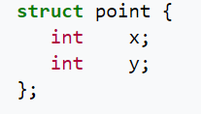
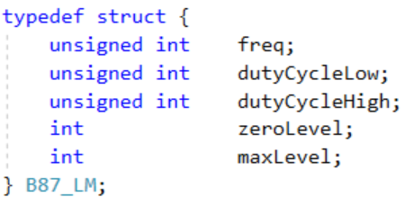
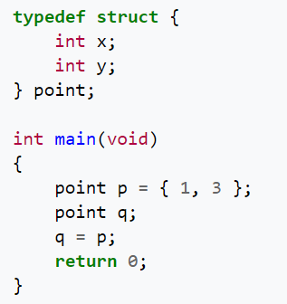
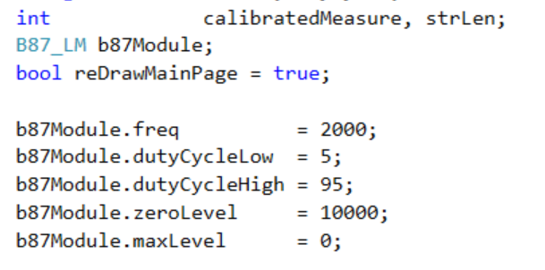
Struct in C and typedef
Composite data type
Grouped list of variables under one name
Accessed via a single pointer or by the struct declared name
Example:

Slide 6
Class in c++
A user-defined type or data structure
Has data and functions (also called member variables and member functions)
  Can be accessed as with struct
Variables members and functions can be:
  Public
  Private
  Protected
Constructor: a special member function, executed whenever we create new objects of the class
  Have the exact same name as the class
  Does not have a return type
  Useful for setting initial values for member variables
Destructor: a special member function, executed the class is deleted or released
  Have the exact same name as the class prefixed with a tilde (~)
  It can neither return a value or take any parameters
  Useful for releasing resources like releasing memories and closing files

Slide 7
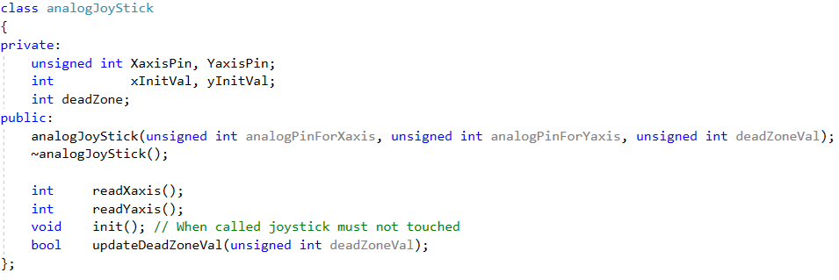

Class in c++

Slide 8
Inheritance
Once we have a class we can inherit from it to form a new class with expanded capabilities
  Derived class (child): the class that inherits from another class
  Base class (parent): the class being inherited from
To inherit from a class we use the “:” symbol
Multiple Inheritance: a class can also be derived from more than one base class
Access Specifiers:
  Public: members of a class are accessible from outside the class
  Private: members can only be accessed within the class
  Protected: members cab be accessed within the class and in the inherited class

Slide 9
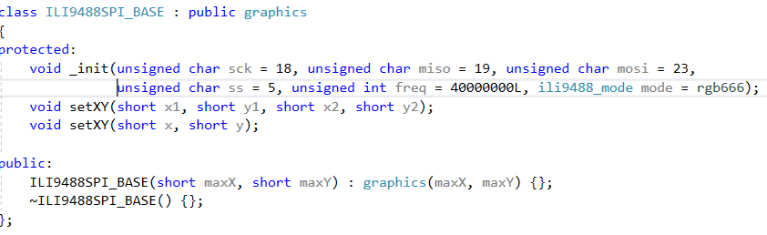
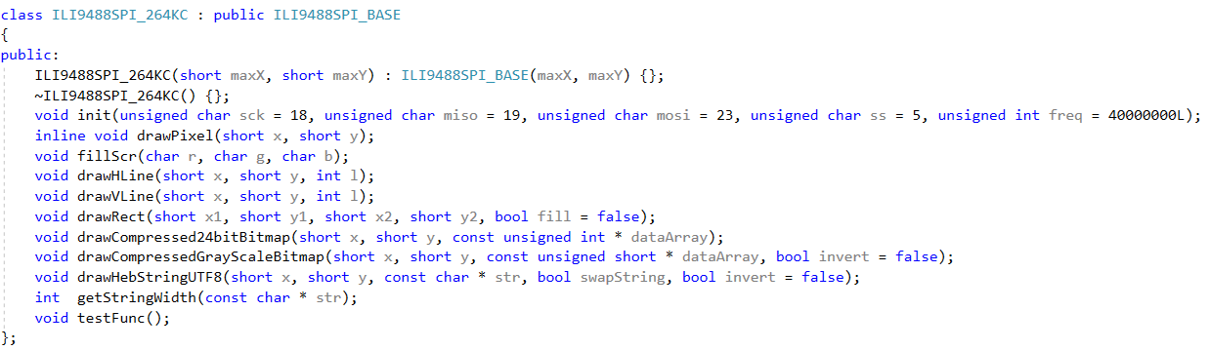
Inheritance

Slide 10
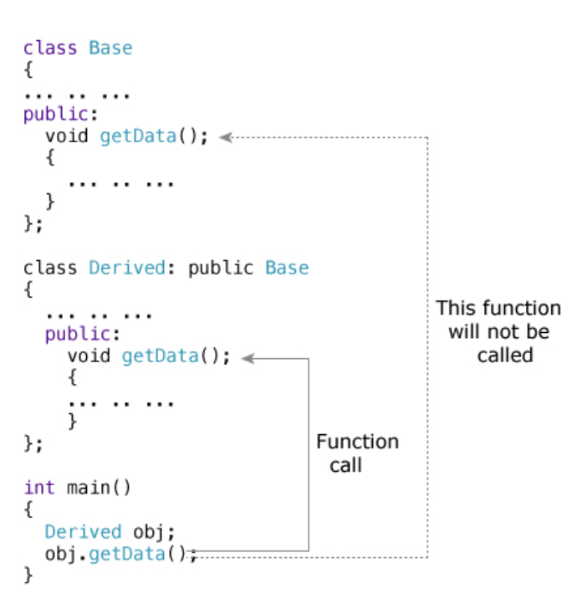
Function Overriding
A child class inherits data and function members of parent class
Overriding is a redefinition of base class function in its derived class
  The two functions have the same signature
  It can only be done in derived class
Used to override the functionality in the child class
To access the overridden function of the base class:
  scope resolution operator :: is used
  Example:
    If you want to access getData() of the base class:
    Use the following in the derived class:

Slide 11
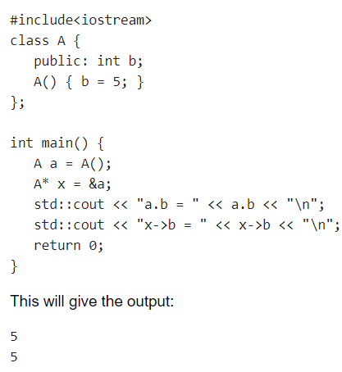
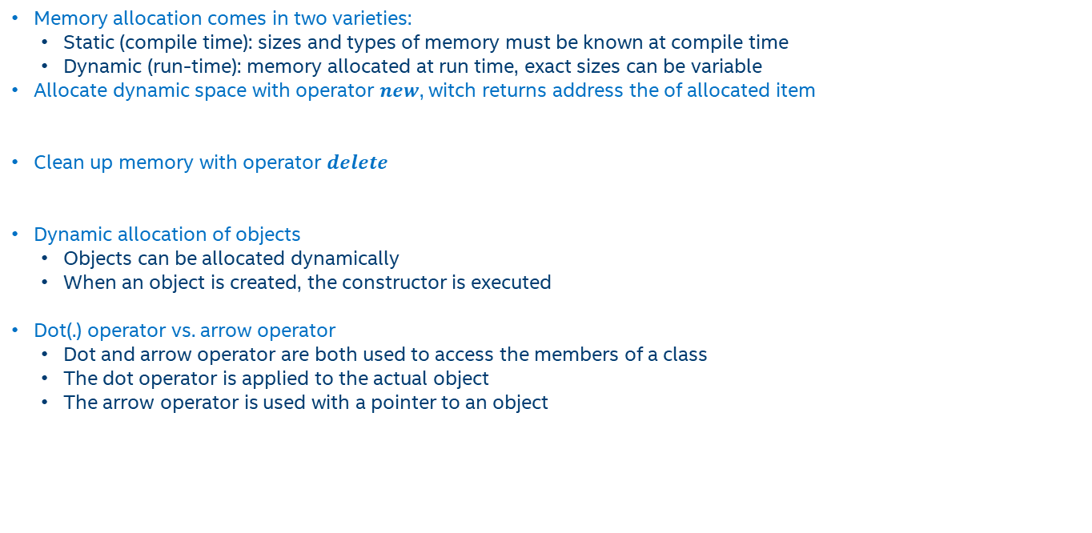
Static Instance VS dynamic allocation (. Vs ->)
Memory allocation comes in two varieties:
  Static (compile time): sizes and types of memory must be known at compile time
  Dynamic (run-time): memory allocated at run time, exact sizes can be variable
Allocate dynamic space with operator $new$, witch returns address the of allocated item
Clean up memory with operator $delete$
Dynamic allocation of objects
  Objects can be allocated dynamically
  When an object is created, the constructor is executed
Dot(.) operator vs. arrow operator
  Dot and arrow operator are both used to access the members of a class
  The dot operator is applied to the actual object
  The arrow operator is used with a pointer to an object

Slide 12


Function OVERLOADING
Two or more functions can have the same name but different parameters
There are two ways to overload a function:
  Having a different number of argument
  Having different arguments types
Instead of defining two functions that should do the same thing, it is better to overload one
Overloaded functions may or may not have different return type, but it should have different arguments
  In the example below, even though the functions have different return types, it is not valid
  The parameter list should be different

Slide 13

Default parameters
A default argument is a default value provided for a function parameter
  If we do not supply an explicit argument, the default value will be used
  If we do supply an argument for the parameter, the user-supplied argument is used
All default arguments must be for the rightmost parameters. The following is not allowed:
A function can have multiple default arguments
Functions with default arguments may be overloaded. But:
  The default parameter do NOT count towards the parameter that make the function unique
  The following is not allowed:

Slide 14
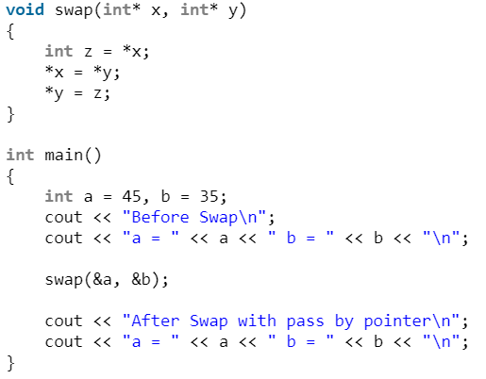


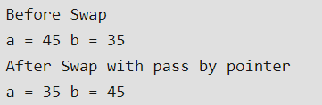
Parameters by value\reference\pointer
A pointer variable holds the memory address of some other variable
A reference variable “refers to” another variable
Pass by value when:
  The function does not want to modify the parameter
  The value is simple to copy
Pass by pointer when:
  The value is expensive to copy
  There is a need to modify the value
Pass by reference when:
  The value is expensive to copy
  The function want to modify the value referred to
  NULL would not be a valid value if a pointer was used instead

Slide 15
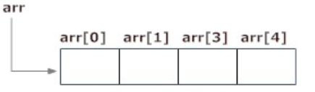



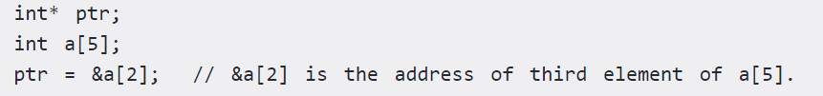
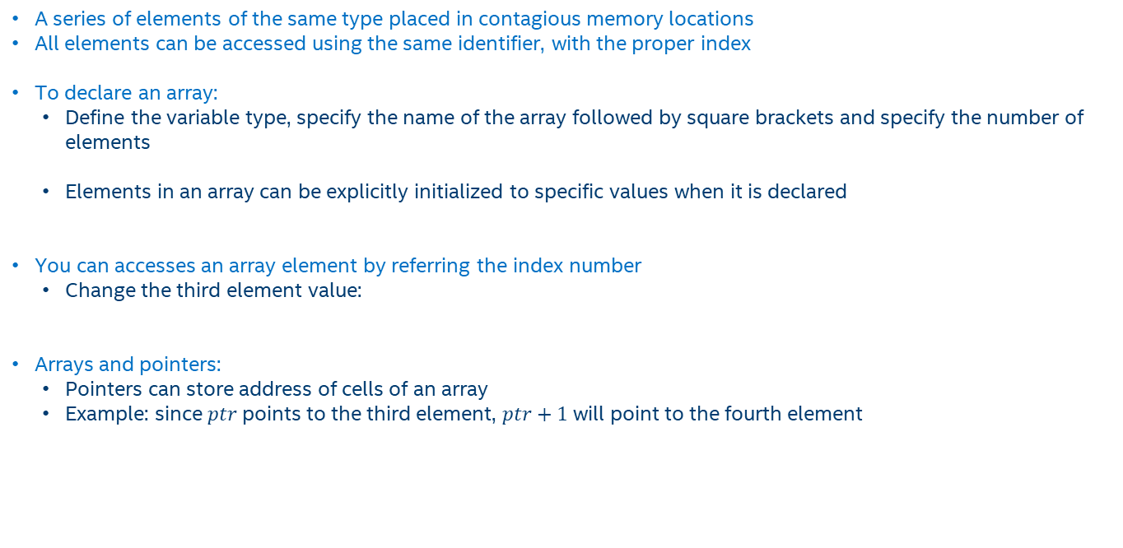
C++ Arrays
A series of elements of the same type placed in contagious memory locations
All elements can be accessed using the same identifier, with the proper index
To declare an array:
  Define the variable type, specify the name of the array followed by square brackets and specify the number of elements
  Elements in an array can be explicitly initialized to specific values when it is declared
You can accesses an array element by referring the index number
  Change the third element value:
Arrays and pointers:
  Pointers can store address of cells of an array
  Example: since $ptr$ points to the third element, $ptr+1$ will point to the fourth element

Slide 16

CASTING
A cast is a special operator that forces one data type to be converted into another
Other casting operators supported by C++
  dynamic_cast: a run-time cast, performs casts on polymorphic types
  static_cast: performs a nonpolymorphic cast, it can be used to cast a base class pointer into a derived class pointer
  reinterpret_cast: changes a pointer to any other type of pointer
  static_cast: used explicitly to override const and/or volatile in a cast

Slide 17

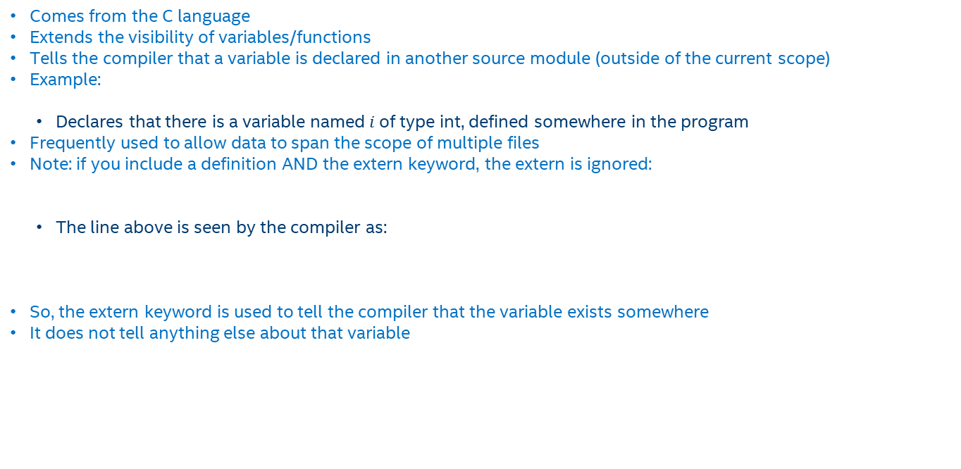
EXTERN
Comes from the C language
Extends the visibility of variables/functions
Tells the compiler that a variable is declared in another source module (outside of the current scope)
Example:
  Declares that there is a variable named$i$of type int, defined somewhere in the program
Frequently used to allow data to span the scope of multiple files
Note: if you include a definition AND the extern keyword, the extern is ignored:
  The line above is seen by the compiler as:
So, the extern keyword is used to tell the compiler that the variable exists somewhere
It does not tell anything else about that variable

